Slide 1
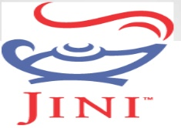
Jini Technology
Presented By:
Avneesh Mishra
CSE(7th SEmester)
Roll no: 1334210009

Slide 2
Contents
What is Jini Technology
History of Jini Technology
Why Jini Technology
Purpose of Jini Technology
Jini-Service Oriented Architecture(SOA)
Jini Process
Structure of Jini Technology
Where Jini is Used
Advantages and Disadvantages
Conclusion
References

Slide 3
What is Jini Technology
Jini is a network architecture for the construction of distributed systems in the form of modular co-operating services.
Jini is also known as Apache River.
Jini is actually a Java Program that serves as a translator for communication between computer and other devices on the network.
This programming model enables the construction of secure, distributed systems consisting of federations of well-behaved network services.
Jini technology provides simple mechanisms that enable devices to plug together to form an impromptu community put together without any planning, installation, or human intervention.
The Java programming language is the key to making Jini technology work.

Slide 4
Devices in a network employing Jini technology are tied together using Java Remote Method Invocation (RMI).
The overall goal is to turn the network into a flexible, easily administered tool with which resources can be found by human and computational clients.
Resources can be implemented as either hardware devices, software programs, or a combination of the two.
The focus of the system is to make the network a more dynamic entity that better reflects the dynamic nature of the workgroup by enabling the ability to add and delete services flexibly.
The Jini system federates computers and computing devices into what appears to the user as a single system.
It relies on the existence of a network of reasonable speed connecting those computers and devices.

Slide 5
History of Jini Technology
Sun introduced Jini in July 1998. In November 1998, Sun announced that there were some firms supporting Jini.
The idea of the Jini system sprang from Sun cofounder Bill Joy at Sun Aspen Smallworks R&D lab in 1994.
Under the leadership of Bill Joy and Jim Waldo on January 25, 1999, Jini was officially launched and the technology is available for download.

Slide 6
Why Jini Technology
Today devices are unaware of their surroundings.
They are rigid and they cannot adapt.
We expend a lot of efforts to install it.
We need an expert to do it for us. We call that expert System Administrator.
In Jini, no System Administrator required.
Everything on network (hardware or software) is a “service”.
Each service represented by mobile object.

Slide 7
Purpose of Jini Technology
To enable users to share services and resources over a network.
To provide users the ability to access resources anywhere easily on the network, even though the network location of the user may constantly change.
To simplify the task of creating and managing network devices, software services, and users.

Slide 8
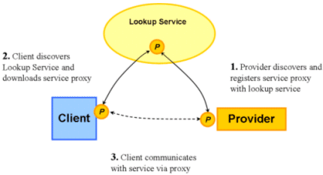
Jini-Service Oriented Architecture(SOA)

Slide 9
Jini Process
Basically there are three processes:
Discovery :- Discovery is used by both the Jini services and Lookup Locator services to announce their presence on a distributed Jini network. Jini services use this to obtain Lookup service proxies, while Lookup services use this to announce their presence on the network. The discovery process uses three types of subprotocols, depending on the state a Jini component is in. They are
  Multicast Request Protocol — Used by a new Jini service to call anonymous Lookup services on a LAN using multicast UDP.
  Multicast Announcement Protocol — Used by Lookup services to announce their presence on a LAN using multicast UDP.
  Unicast Request Protocol — Used by Jini services contacting far Lookup services using Unicast TCP.

Slide 10
Join :- The join process is used to register the Jini service proxy at the Lookup service through the Lookup service proxy obtained in discovery.
Lookup :- A distributed Jini client looking up for a Jini service obtains a Jini service proxy from the Lookup service proxy it has. The client selects a template mask for its service and requests it from the Lookup service proxy. Only service proxies that match the mask template are returned.

Slide 11
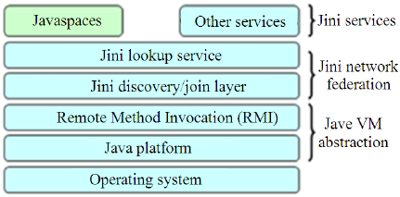
Structure of Jini Technology

Slide 12
JavaSpaces
This technology is written in the Java language and is a simple, fast and unified mechanism for dynamic communication and sharing of objects.
This is a Jini service that stores Java Objects in memory.

Slide 13
Lookup Service
The lookup service is the heart of Jini.
Lookup Service may include entry for other lookup services.
When new services become available on the network, they register themselves with a lookup service.
When clients wish to locate a service to assist with some task, they consult a lookup service.

Slide 14
Remote Method Invocation(RMI)
RMI is the object oriented equivalent to RPC(Remote Procedure Call).
The Java RMI system allows an object running in one JVM(Java Virtual Machine) to invoke methods of an object running in another JVM.
RMI is an API that provides a mechanism to create distributed application in Java.
RMI provides remote communication between the applications using two objects stub and skeleton.

Slide 15
Where Jini is Used
In any software and hardware.
In any consumer apliances that can pass digital information such as TV Set-Top Box, phones, DVD's etc.

Slide 16
Advantages and Disadvantages
Advantages
Jini is open-source, meaning source code is available for everyone.
Jini suports an extremely flexible network as Services and Clients can move code to where it is needed.
New services are easy to program in Java and can be easily added to the network.
Disadvantages
The client may incur larger overheads compared to other technologies.
It must have Java Virtual Machine installed as well as the code that is downloaded from the network.
This would be a problem for desktop computers but it would be problem for small mobile devices.

Slide 17
Conclusion
Jini provides an extensive framework for developing robust and flexible distributed systems. In addition to that it offers capabilities, which are required to fulfill the needs of modern end users of the network services.

Slide 18
References
https://www.techopedia.com/definition/1304/jini
https://en.wikipedia.org/wiki/Jini
http://www.slideshare.net/Dipshalimbasiya/sem-3-jini-technology
http://www.slideshare.net/keerthi19/jini-network-technology-15765027
http://www.oracle.com/technetwork/articles/javase/jinievents-140780.html
https://river.apache.org/doc/specs/html/jini-spec.html
http://www.slideshare.net/rachna__singh/jini-technology?qid=a71ee7fb-ae2b-4bbc-b1ad-d5824f78fa4d&v=&b=&from_search=2
http://gsraj.tripod.com/jini/chapter/

Slide 19

Thank you

